Slide 1
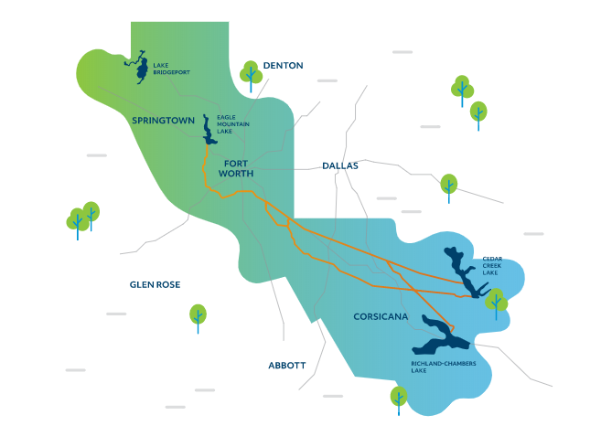

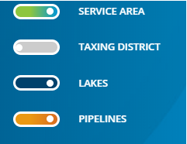
MISSION
Mission:
Water supply
Flood control
Recreation
  Enhance the quality of life in North Texas communities by creating recreations opportunities around TRWD infrastructure to enable active lifestyles.
  Reduce the risk of flooding in our communities with dependable flood damage reduction infrastructure and operations.
TRWD Service Area
Notes:
This presentation is supported by our regional water supplier - Tarrant Regional Water District. TRWD maintains 4 area lakes and pipelines needed to provide surface water to local water treatment plants so they can clean it to meet drinking water standards for our communities. They also work with many cities in Tarrant County, such as Fort Worth, Arlington, Mansfield, and (insert city name you are in) to provide water conservation programs to the community.

Slide 2




Conservation is an Important Water Supply Strategy
Sign up for a free sprinkler check for Tarrant County residents
Sign up for free weekly watering advice custom to your location
Calendar of events, classes, etc.
Water-saving tips and videos
Notes:
Conservation is an important water supply strategy to help meet the needs of a growing population. There are currently 2.3 million people in Tarrant County and this is expected to double over the next 50 years. That is why TRWD supports many programs that help save water through outdoor watering and gardening education. At SaveTarrantWater.com, you can sign up for free weekly watering advice custom to your location. If you are a resident of Tarrant County, you can sign up for a free sprinkler system check-up where a licensed irrigator comes to your home and provides a comprehensive evaluation of your system with recommendations to reduce water waste. There is also an event calendar where you can find information about future classes and workshops. TRWD also partners with organizations like Texas A&M AgriLife Extension Service and the Tarrant County Master Gardeners to provide educational programs like this one. Be sure to check out SaveTarrantWater.com and sign up for their free services.

